Slide 1
Computer Architecture and Organization
Week_9
Memory-2
Dr. Abdul Hameed Pitafi

Slide 2
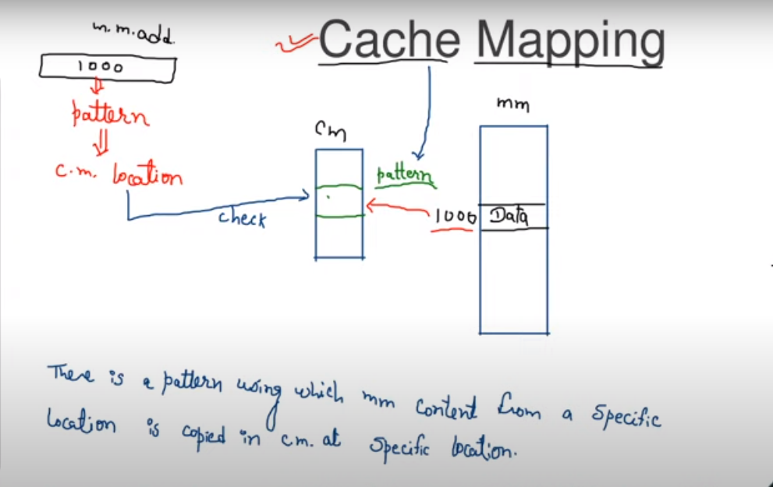
Cache Mapping
CPU always generates the address of main memory.

Slide 3
Cache Memory
The cache contains a copy of portions of main memory. When the processor attempts to read a word of memory, a check is made to determine if the word is in the cache. If so, the word is delivered to the processor. If not, a block of main memory, consisting of some fixed number of words, is read into the cache and then the word is delivered to the processor.
Because of the phenomenon of locality of reference, when a block of data is fetched into the cache to satisfy a single memory reference, it is likely that there will be future references to that same memory location or to other words in the block.

Slide 4
Mapping Function
Because there are fewer cache lines than main memory blocks, an algorithm is needed for mapping main memory blocks into cache lines
Three techniques can be used:
Direct
The simplest technique
Maps each block of main memory into only one possible cache line
Associative
Permits each main memory block to be loaded into any line of the cache
The cache control logic interprets a memory address simply as a Tag and a Word field
To determine whether a block is in the cache, the cache control logic must simultaneously examine every line’s Tag for a match
Set Associative
A compromise that exhibits the strengths of both the direct and associative approaches while reducing their disadvantages
Notes:
Because there are fewer cache lines than main memory blocks, an algorithm is
needed for mapping main memory blocks into cache lines. Further, a means is
needed for determining which main memory block currently occupies a cache line.
The choice of the mapping function dictates how the cache is organized. Three
techniques can be used: direct, associative, and set associative.
Direct mapping: The simplest technique, known as direct mapping, maps each
block of main memory into only one possible cache line.
Associative mapping: Associative mapping overcomes the disadvantage of direct
mapping by permitting each main memory block to be loaded into any line of the
cache.
Set-associative mapping: Set-associative mapping is a compromise that
exhibits the strengths of both the direct and associative approaches while reducing
their disadvantages.

Slide 5
Direct Mapping: Pros and Cons
The direct mapping technique is simple and inexpensive to implement. Its main disadvantage is that there is a fixed cache location for any given block. Thus, if a program happens to reference words repeatedly from two different blocks that map into the same line, then the blocks will be continually swapped in the cache, and the hit ratio will be low (a phenomenon known as thrashing).

Slide 6
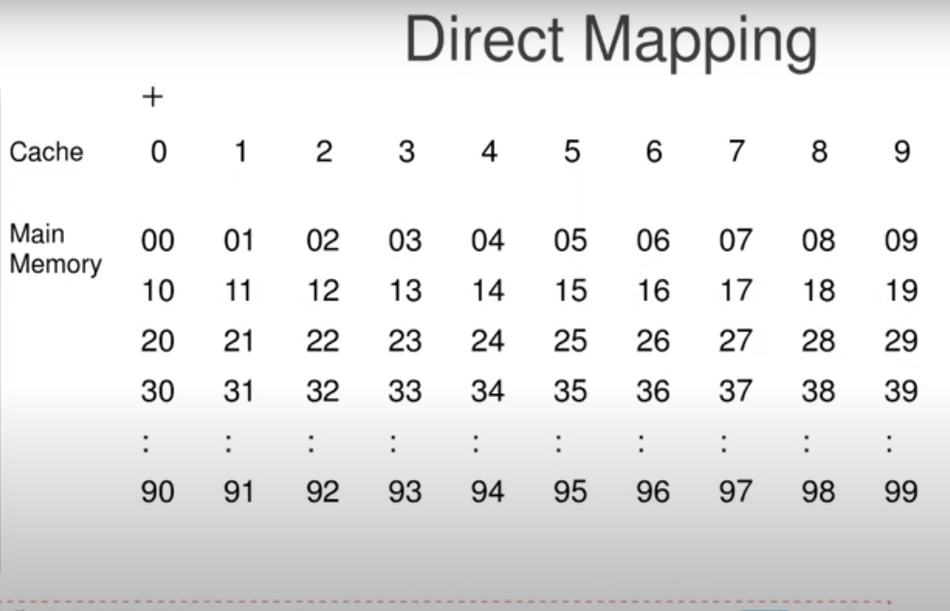

Slide 7
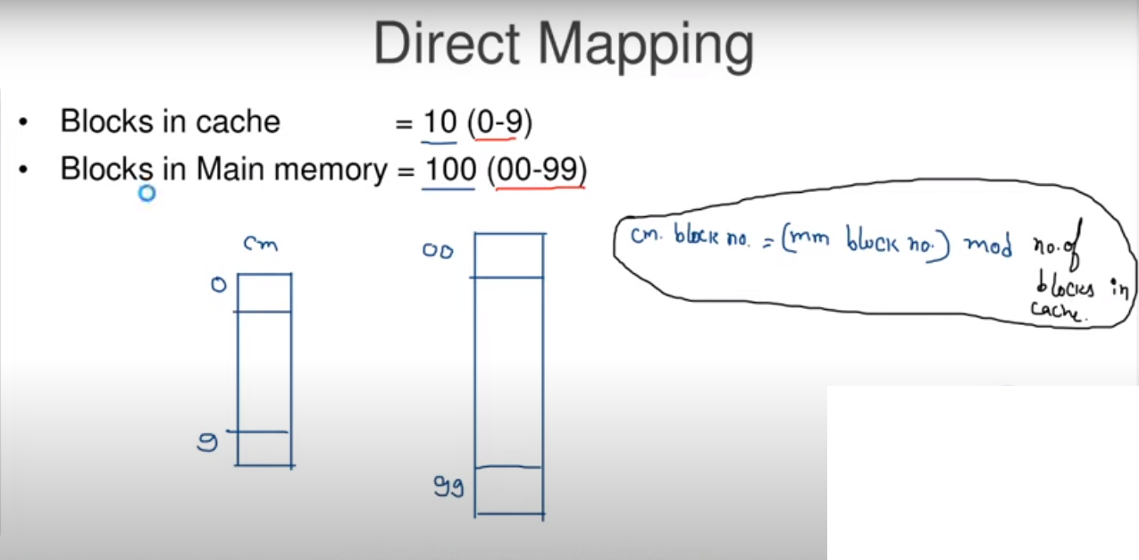

Slide 8
Direct Mapping
The mapping is expressed as
i = j modulo m
where
i = cache line number
j = main memory block number
m = number of lines in the cache

Slide 9
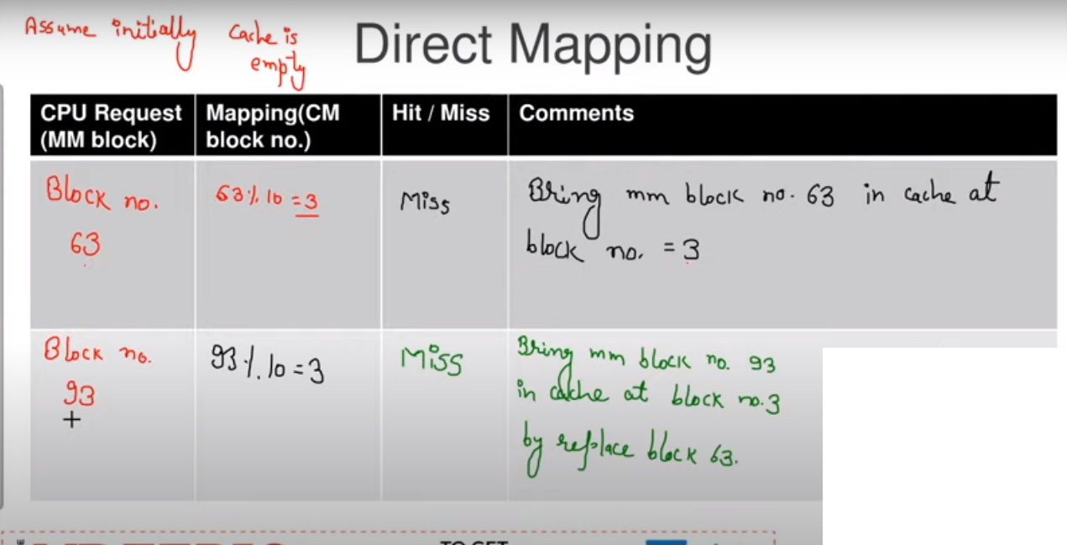

Slide 10
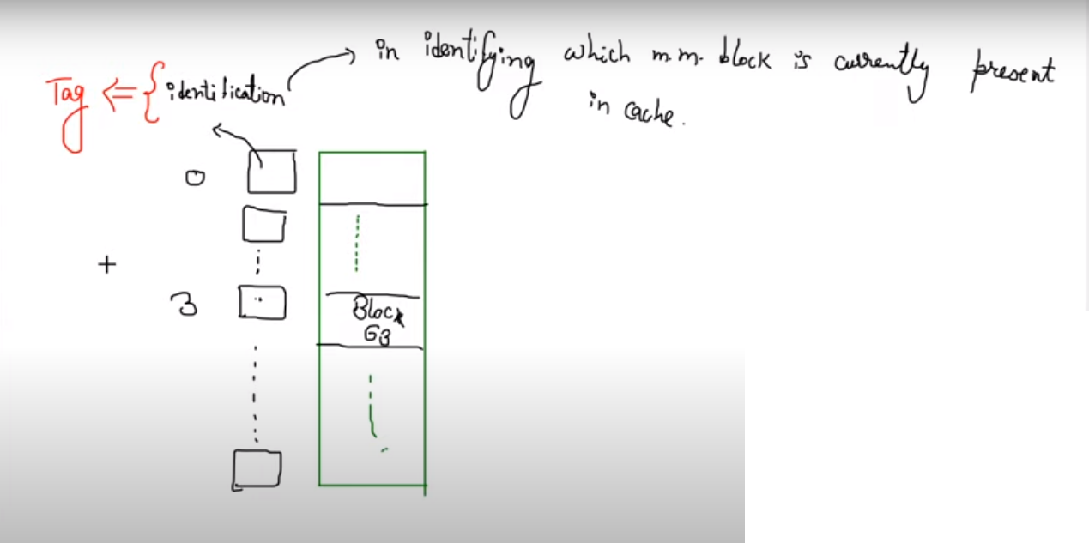

Slide 11
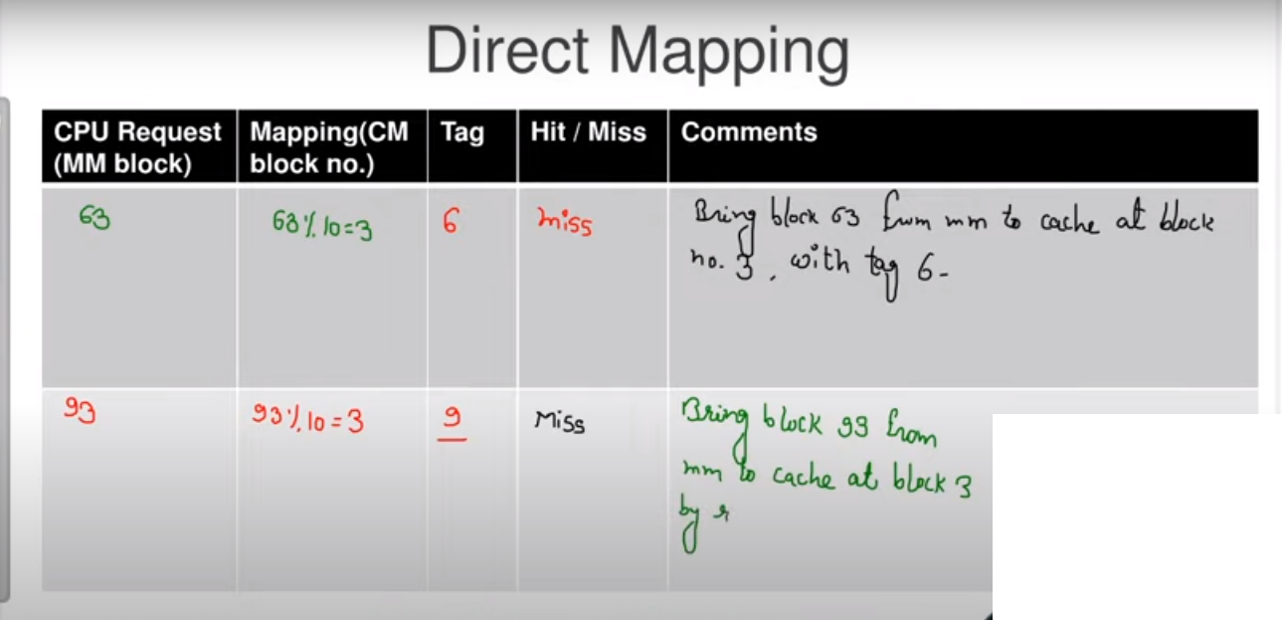

Slide 12
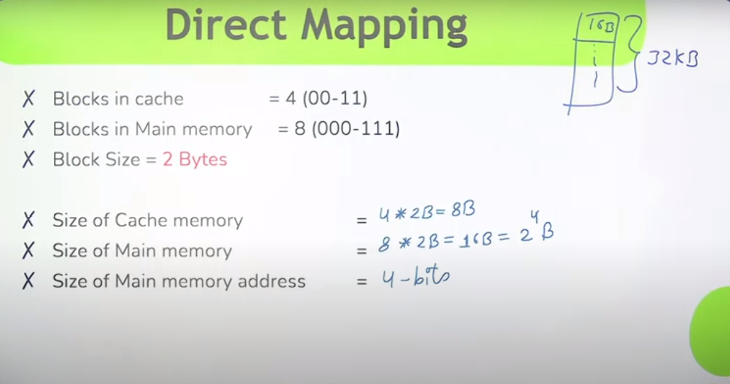

Slide 13
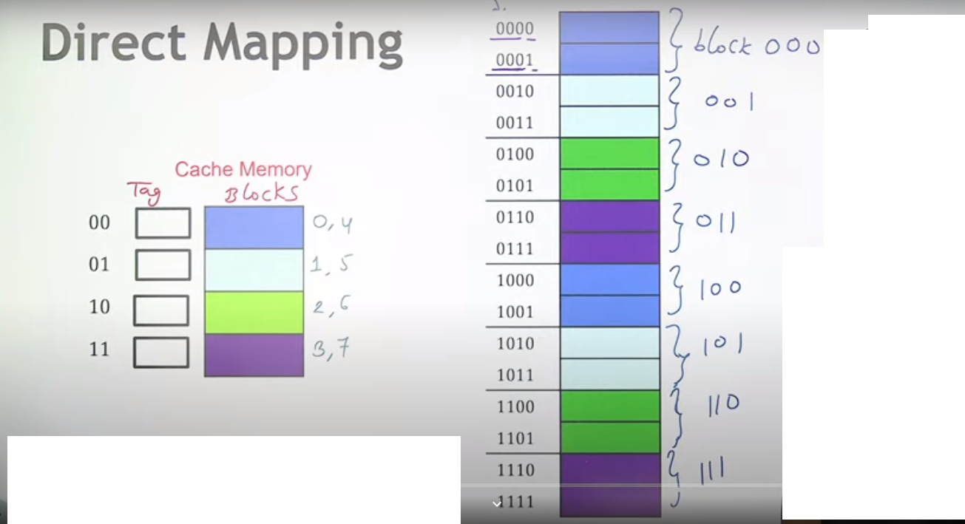

Slide 14
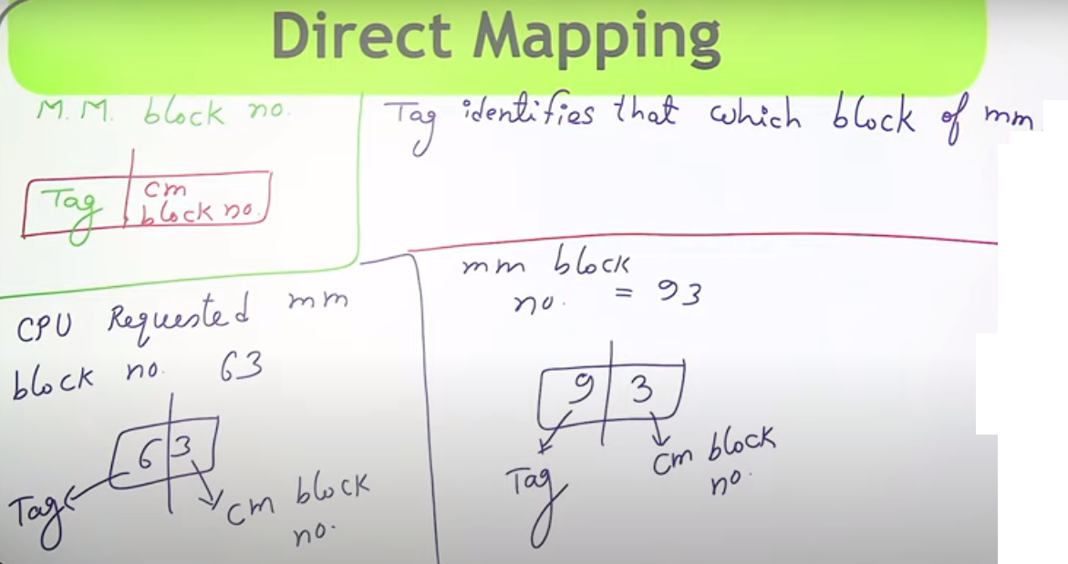

Slide 15
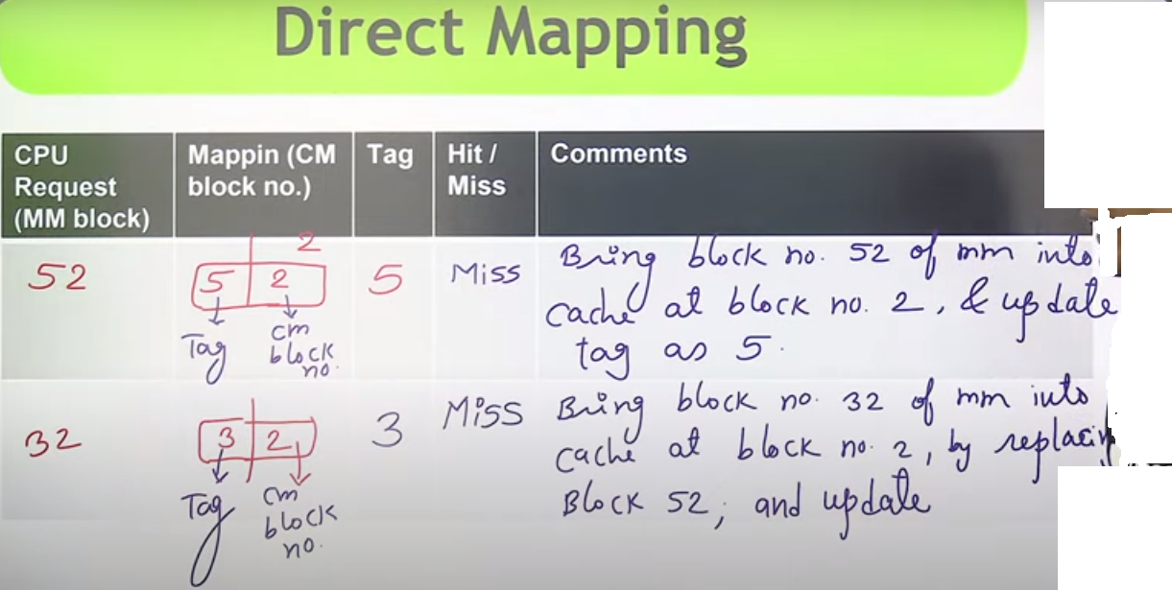

Slide 16
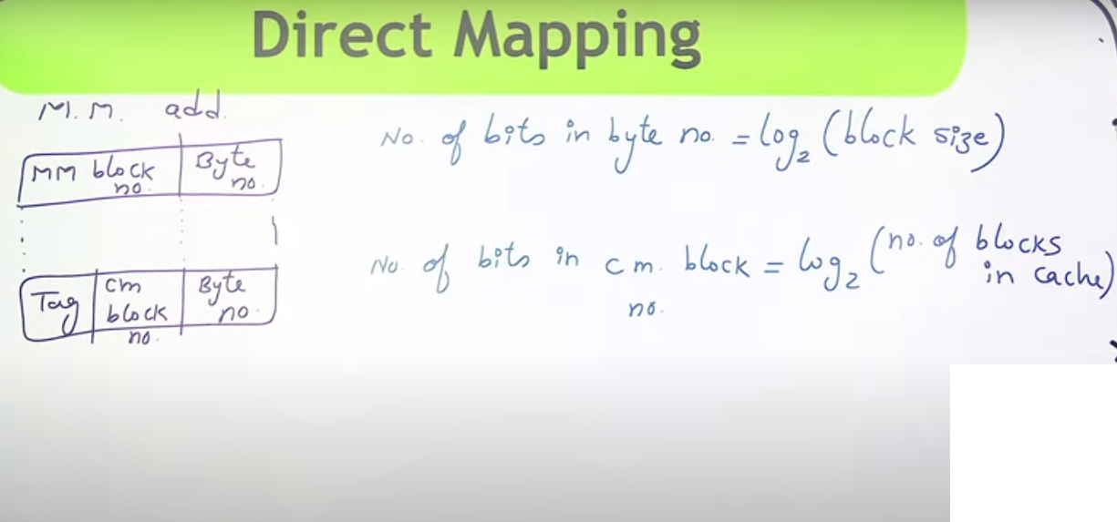

Slide 17
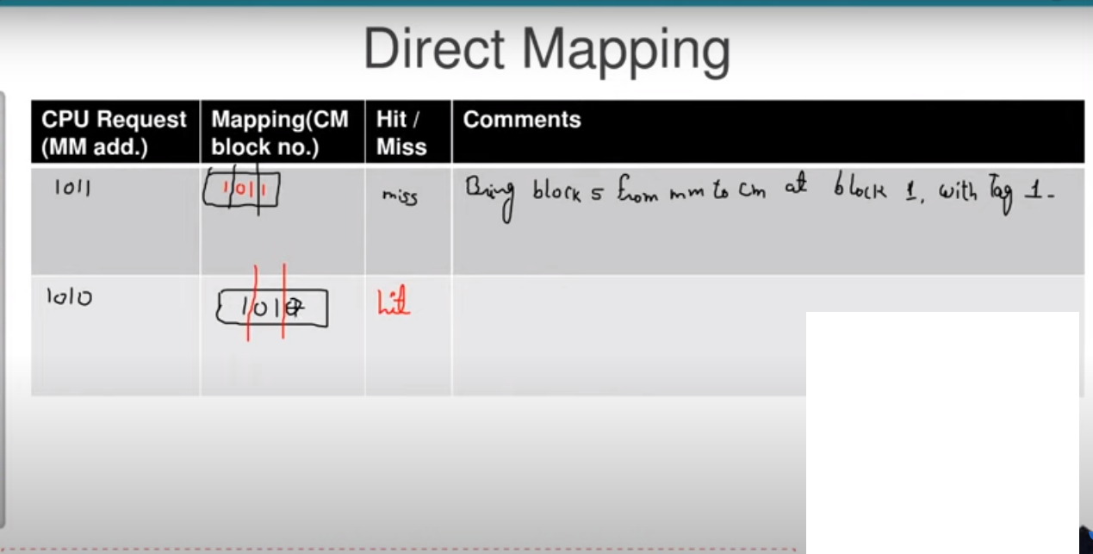

Slide 18
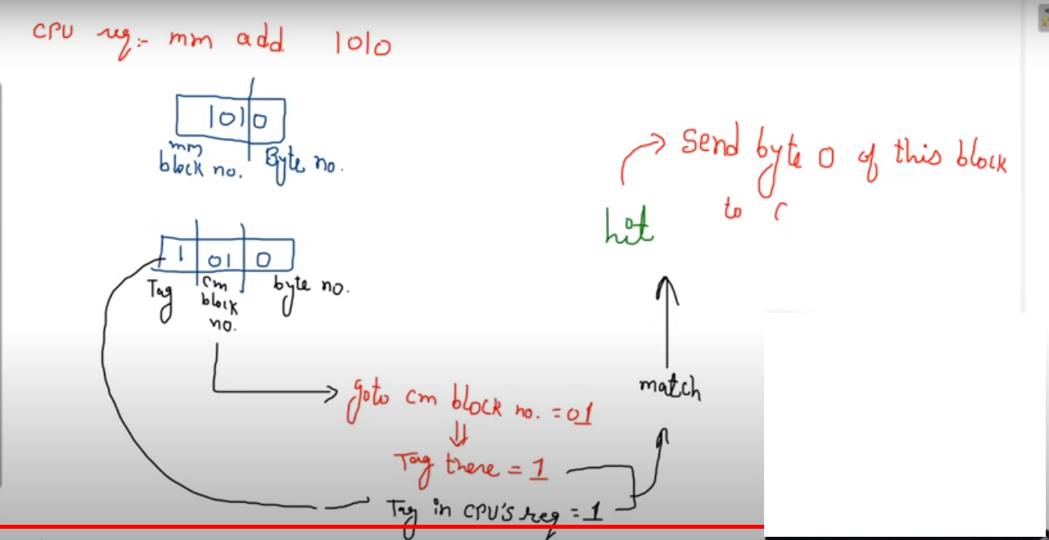

Slide 19
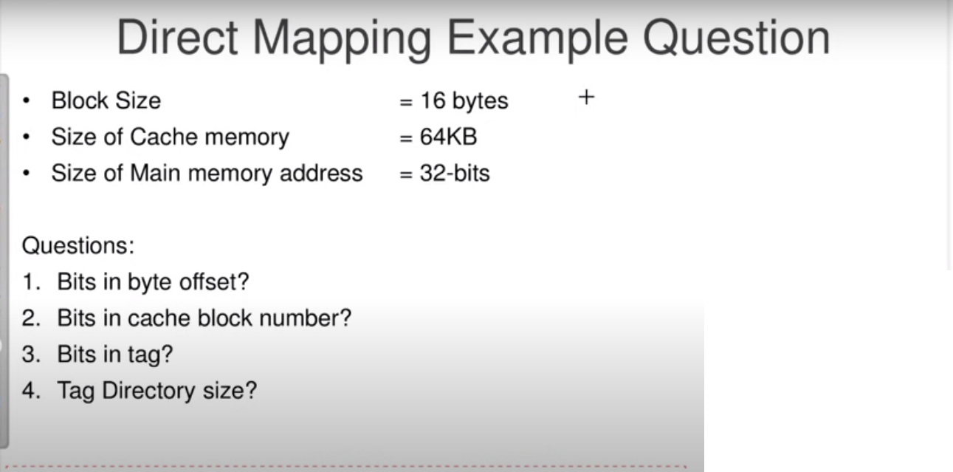

Slide 20
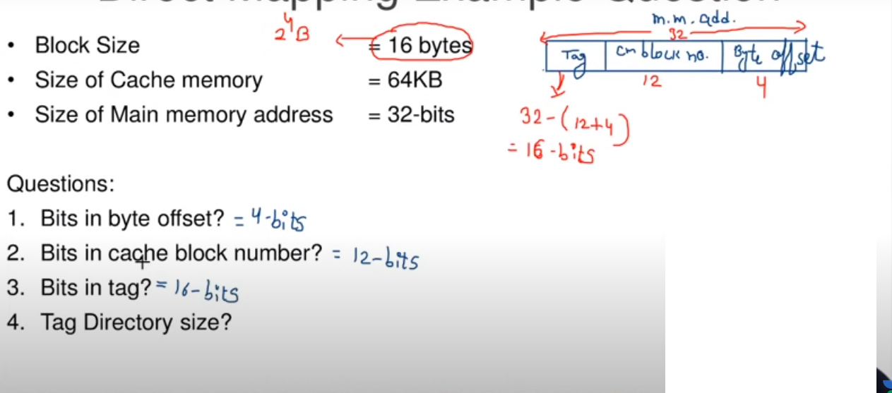

Slide 21
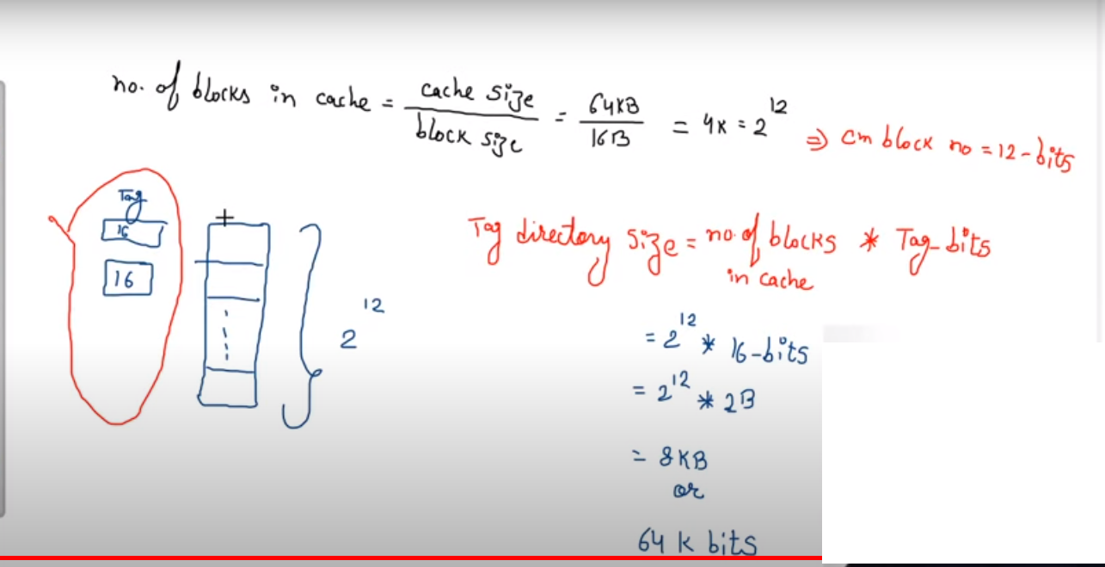

Slide 22
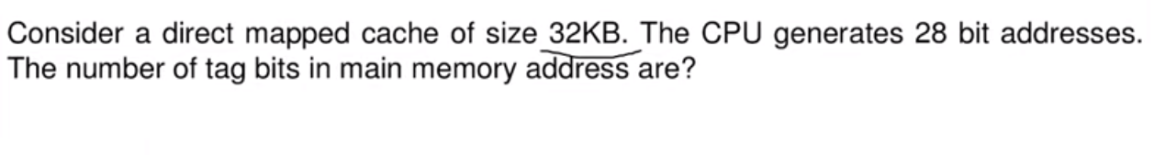
Q:1

Slide 23
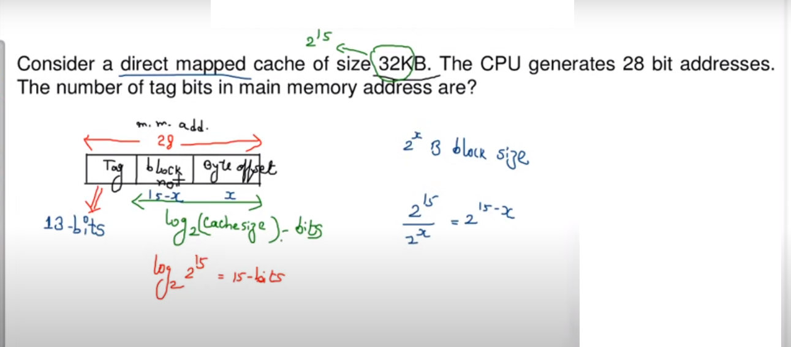

Slide 24
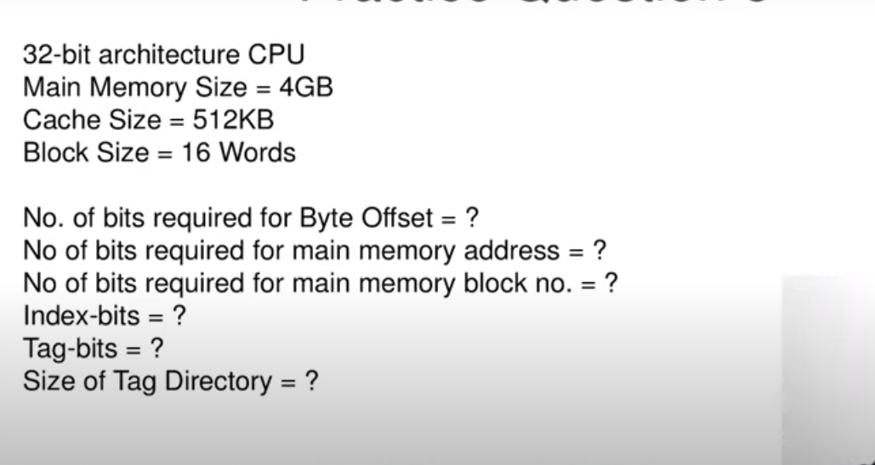

Slide 25
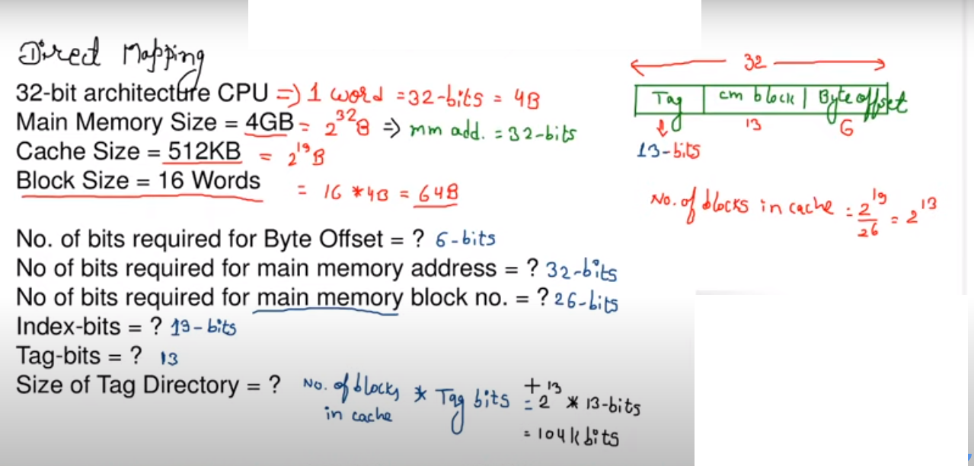

Slide 26
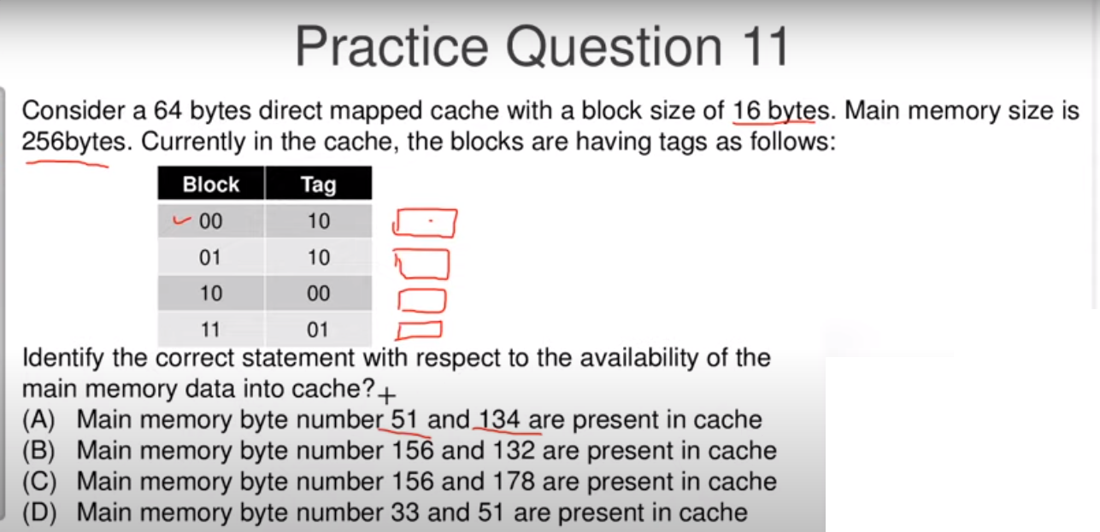

Slide 27
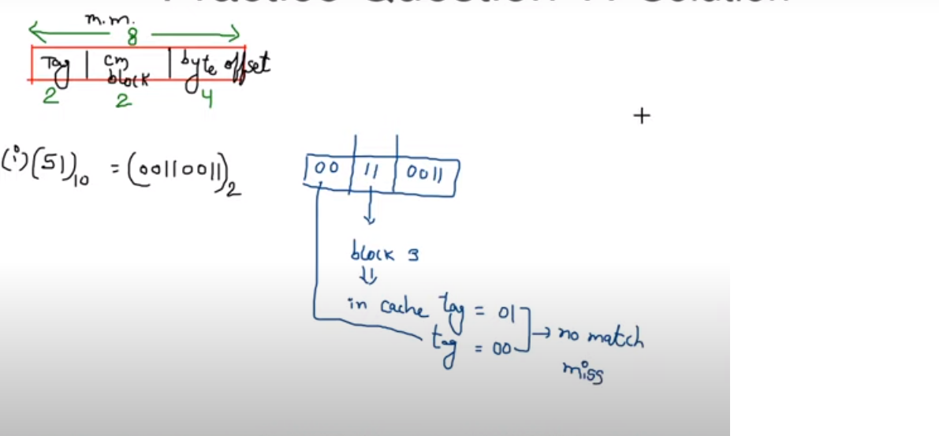
Solution

Slide 28
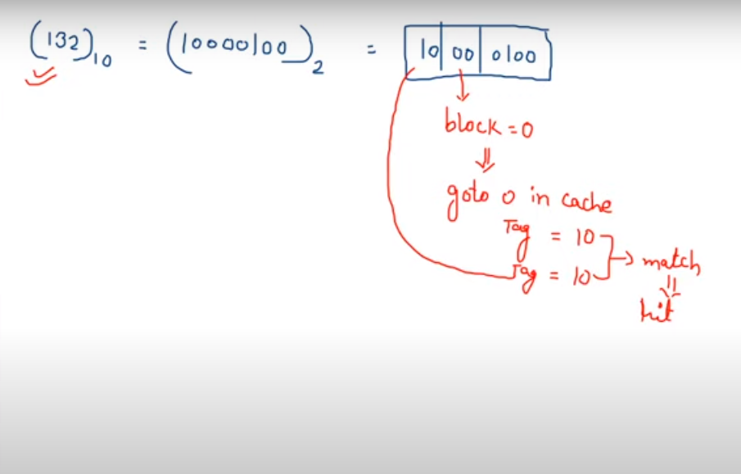

Slide 29
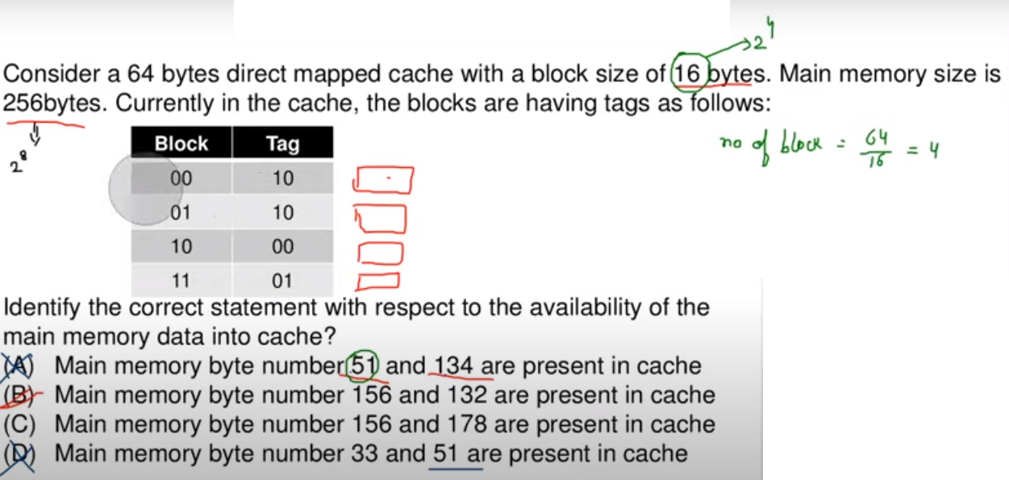

Slide 30
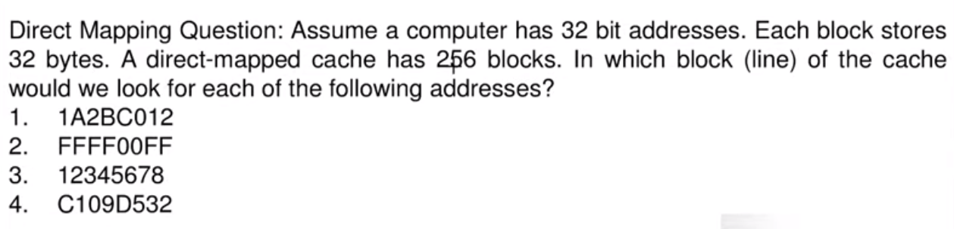

Slide 31
